Slide 1
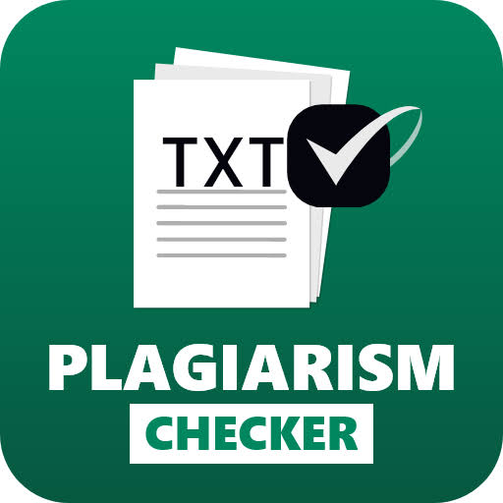
PLAGARISM CHECKER
GROUP 1
Parthib Saha
Onkar Chaudhary
Prasant Pradhan
Samarpan Thapa
Debajyoti Loha

Slide 2
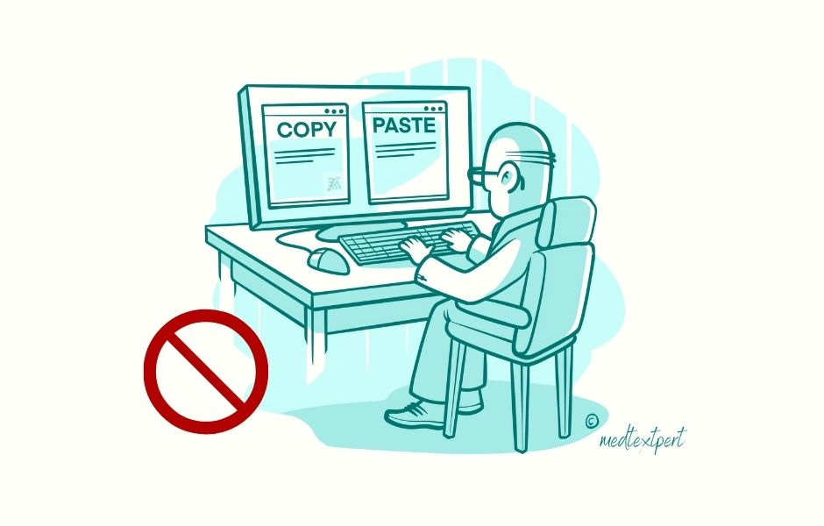
What is Plagiarism?
Plagiarism is the act of using someone else's work and presenting it as your own without giving proper attribution. It can occur in different forms, such as copying and pasting someone else's text, paraphrasing their work without proper citation, or using someone else's ideas without giving them credit.

Slide 3
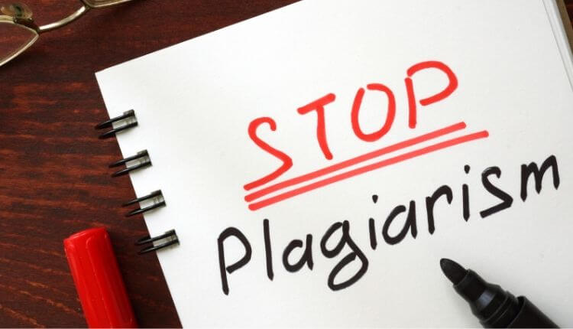
Why Use a Plagiarism Checker?
Using a plagiarism checker can help you identify instances of plagiarism in your work before submitting it. It can also help you ensure that your work is original and free of any copied content. Additionally, plagiarism checkers can be useful for educators to check students' work for plagiarism.

Slide 4
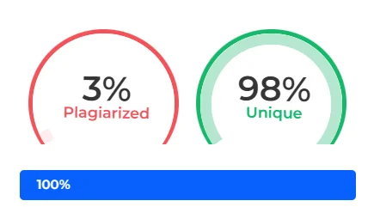
How Plagiarism Checker works
Plagiarism checker scans your text and compares it with billions of online sources, such as books, websites, journals, and databases. It then shows you any matches or similarities that it finds and gives you a report with the percentage of plagiarism and the sources of the matched text.
7

Slide 5
Advantages of Plagiarism Checker
- It provides links to the source text that is plagiarized, which can help you cite them properly or rewrite them in your own words.
- It works fast and scans your text for similarities against a large and varied database of existing content on the internet.
- It provides the similarity percentage, which can indicate how much of your text is original and how much is copied.
- It helps you write original pieces within a short time by highlighting the plagiarism and suggesting ways to improve it.
- It helps you stay within the regulatory and ethical limits and avoid the consequences of plagiarism, such as academic penalties, legal issues, or damage to your reputation.

Slide 6
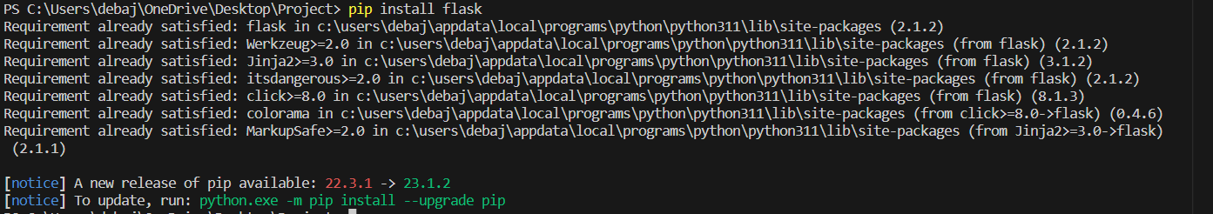
Step 1: Install Flask

Slide 7
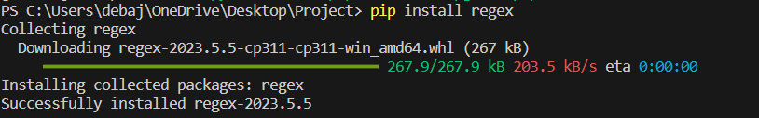
Step 3: Install regex module

Slide 8


Importing the required modules
The modules/libraries we are going to import are flask , regex and math

Slide 9
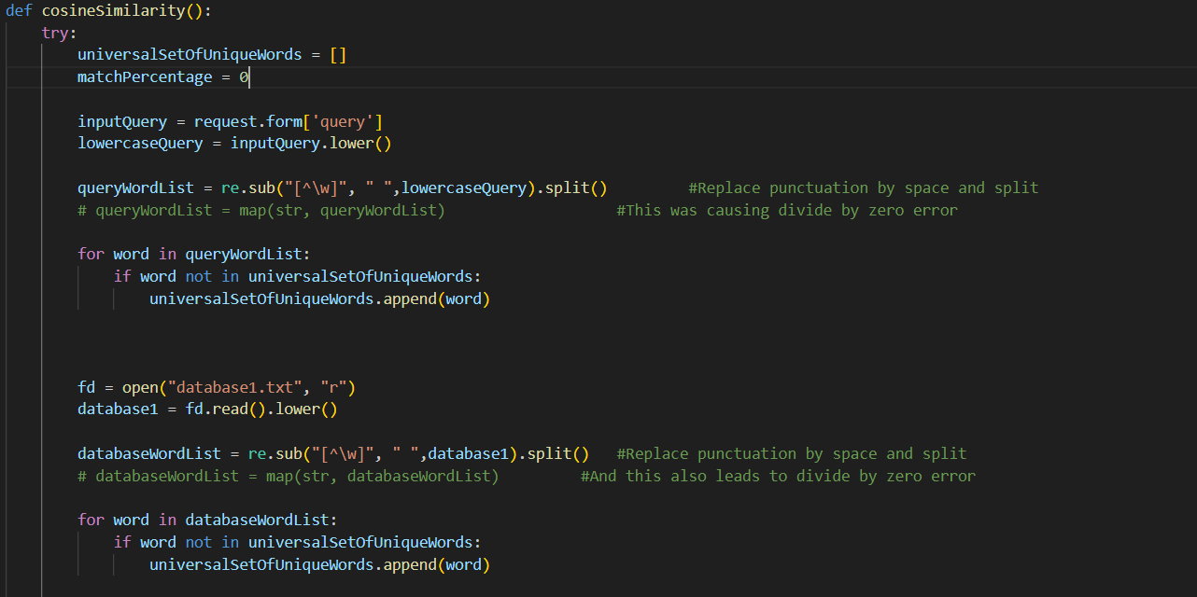
Step 4: Defining cosine function :
To Defining cosine similarity function to check for the similarities between between the database and the query.
plagiarism.

Slide 10
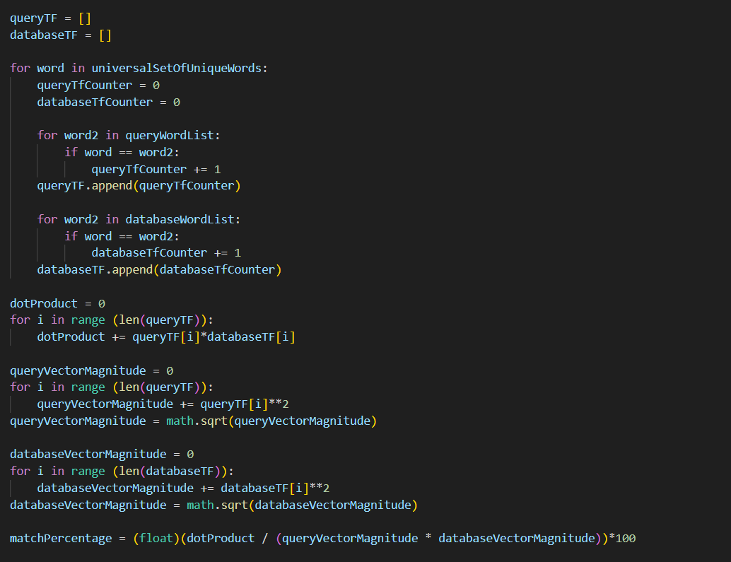
Step 5: Defining the main program which compare the two documents and gives the result

Slide 11
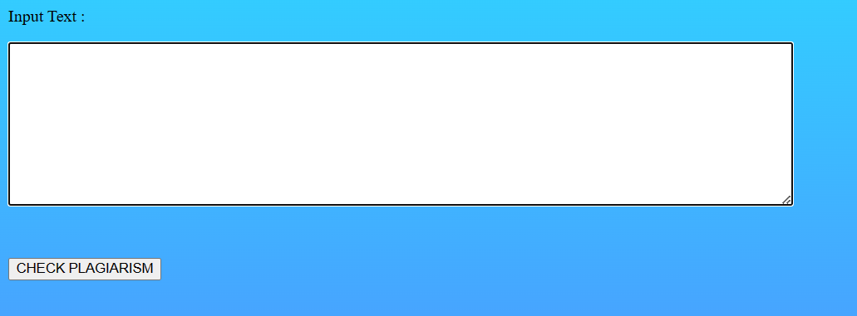
OUTPUT INTERFACE
STEP 1:INPUT THE QUERY TO CHECK PLAGIARISM

Slide 12
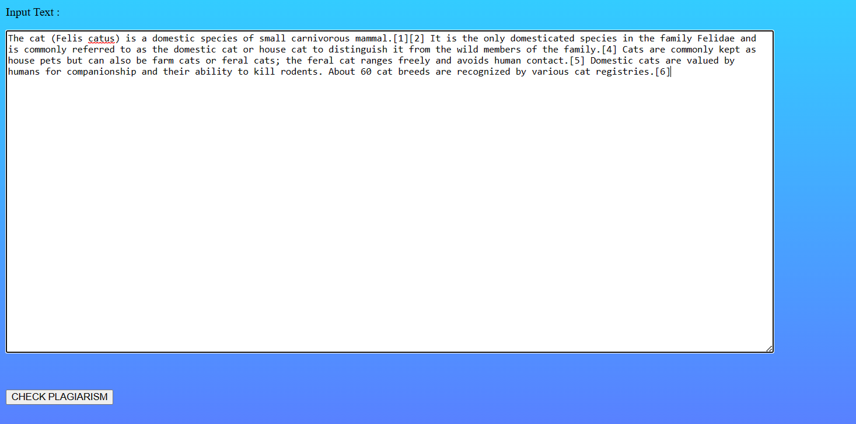
STEP 2: CLICK ON THE CHECK PLAGIARISM BUTTON

Slide 13

RESULT:

Slide 14
Conclusion
The plagiarism checker uses the flask framework for better interface and it
uses the cosine similarity function which checks for the similarities between the two documents(here between the database and the query from the
Plagiarism is definitely one of the issue out in the world as it affects the true creator of the work. This result in the false recognition of the true creator and even can affect the whole organisation with it.
Plagiarism can even affect the company as the recruiters may recruit a person with false skillset which result in the degradation and waste of company’s money . We should definitely took the stand against the plagiarism .

Slide 15


